Slide 1


FULL STACK WEB DEVELOPMENT WITH DJANGO
Lecture 26

Slide 2

Today’s Agenda
Developing Our Django App
Using Django’s Form Library

Slide 3
The Django Form Library
Django comes with a form library, called django.forms, that handles many of the issues we’ve seen in the previous codes
Django handles three distinct parts of the work involved in forms:
preparing and restructuring data to make it ready for rendering
creating HTML forms for the data
receiving and processing submitted forms and data from the client

Slide 4
Creating Django Forms
To create Django Form we have to create a new file called forms.py in the application folder.
This file can have any name but preferred name is forms.py.
Finally we need to write the code shown in next slide in it

Slide 5
Creating Django Forms
Syntax:
from django import forms
class <name> (forms.Form):
<label>=forms.<FieldType>()
<label>=forms.<FieldType>()
Example
from django import forms
class EmpRegistration(forms.Form):
name=forms.CharField() # no need of max_length
email=forms.EmailField()

Slide 6
Creating Django Forms
When the previous form will be rendered by the template then it will be converted to the following HTML code:
<tr>
<th><label for=“id_name”>Name:</label></th>
<td><input type=‘text’ name=‘name’ required id=‘id_name’></td>
</tr>
<tr>
<th><label for=“id_email”>Email:</label></th>
<td><input type=‘email’ name=‘email’ required id=‘id_email’></td>
</tr>

Slide 7
Displaying Django Forms
By just creating the Form class , our form will not be rendered , rather we need to take 2 steps to render it i.e. display it to the user.
These are:
Create an object of the Form class you have defined and pass it as context to the template
Render the Form object in the template

Slide 8
Creating Form Object In View
Create a Form object in the views.py file and then pass it as dictionary value to the template.
Sample Code:
from .forms import EmpRegistration
def showForm(request):
formobj=EmpRegistration()
return render (request,’myapp/showform.html’,{‘regform’:formobj})

Slide 9
Render Form Object in Template
To render the Form object in the template , we simply have to display it as a template variable as shown below
Sample Code:
<!DOCTYPE>
<html>
<head><title>Reg Form</title></head>
<body>
{{ regform }}
</body>
</html>

Slide 10
Render Form Object in Template
This will generate the following HTML code
Sample HTML
<tr>
<th><label for=“id_name”>Name:</label></th>
<td><input type=‘text’ name=‘name’ required id=‘id_name’></td>
</tr>
<tr>
<th><label for=“id_email”>Email:</label></th>
<td><input type=‘email’ name=‘email’ required id=‘id_email’></td>
</tr>
Special Point: Note that there is no <form> tag or <submit> button
generated

Slide 11
Render Form Object in Template
We can ourselves add the <form> and button to the generated HTML code
Sample HTML
<!DOCTYPE>
<html>
<head><title>Reg Form</title></head>
<body>
<form action”/some_url/’ methpd=“get”>
{{ regform }}
<input type=“submit” value=“Register”>
</body>
</html>

Slide 12
Few Points To Remember
The output does not contain <table> or <form> or submit button tags. We must handle it on our own.
Each Field Type has a corresponding HTML 5 representation , for ex , CharField becomes <input type=‘text’> , EmailField becomes <input type=‘email’> and so on.
The name for each tag is taken directly from it’s attribute name in the Form class.

Slide 13
Few Points To Remember
The label i.e. text for each control like ‘Name:’, ‘Email:’ etc is generated by taking the filed name and converting all underscores to spaces and uppercasing the first letter.
Each text label is surrounded by an HTML <label> tag which points to the appropriate control via id.
The id is generated by prepending the ‘id_’ to the attribute name .
Since all the controls are HTML 5 controls so they have HTML 5 validation enabled by default

Slide 14
Developing Contact Form
To understand whatever we have discussed , let’s create a contact form application using the Django forms framework.

Slide 15
Performing Initial Steps
Load the virtual environment in VS CODE
Create a django project called formdemoproj2 by using the command:
django-admin startproject formdemoproj2
This will create the outer project folder called formdemoproj2 and inner app folder also by the same name

Slide 16
Performing Initial Steps
Now go to the outer project folder formdemoproj2 and create an app called djangoformapp by using the command:
django-admin startapp djangoformapp
Now create a folder called templates in the djangoformapp followed by an inner folder called djangoformapp

Slide 17
Performing Initial Steps
Inside templates/djangoformapp create an HTML files called show_contact_form.html
Finally update settings.py so that it contains the name of our app

Slide 18
Performing Initial Steps
Code:
INSTALLED_APPS = [
'django.contrib.admin',
'django.contrib.auth',
'django.contrib.contenttypes',
'django.contrib.sessions',
'django.contrib.messages',
'django.contrib.staticfiles',
‘djangoformapp',
]

Slide 19
Creating Form Class
As discussed , the primary way to use the forms framework is to define a Form class for each HTML <form> we’re dealing with.
In our case, we only have one <form>, so we’ll have one Form class.

Slide 20
Creating Form Class
This class can live anywhere we want – including directly in our views.py file – but community convention is to keep Form classes in a separate file called forms.py.
So ,create this file in the same directory as views.py, and enter the code given on next slide

Slide 21
Creating Form Class
from django import forms
class ContactForm(forms.Form):
subject = forms.CharField()
email = forms.EmailField()
message = forms.CharField()

Slide 22
Understanding Our Form Class
Our form class called ContactForm is similar to Django’s model syntax.
It has to inherit the predefined class forms.Form
Each field in the form is represented by a type of Field class – CharField and EmailField are the only types of fields used here – as attributes of a Form class.
Each field is required by default

Slide 23
Connecting Form Object To Views
After creating the Form classes, our next task is to render it in the browser for the user
For this we will have to do the following:
Create a view function called contact( )
Create the Form object in it
Pass this Form object to the template
Render the Form object in the template

Slide 24
The contact( )View Function
from django.shortcuts import render
from djangoformapp.forms import ContactForm
def contact(request):
form = ContactForm()
return render(request, 'djangoformapp/show_contact_form.html', {'form': form})

Slide 25
Creating The show_contact_form.html Page
<html>
<head>
<title>Contact us</title>
</head>
<body>
<h1>Contact us</h1>
<form>
<table>
{{ form }}
</table>
<input type=‘submit’ value=‘Send’ >
</form>
</body>
</html>

Slide 26
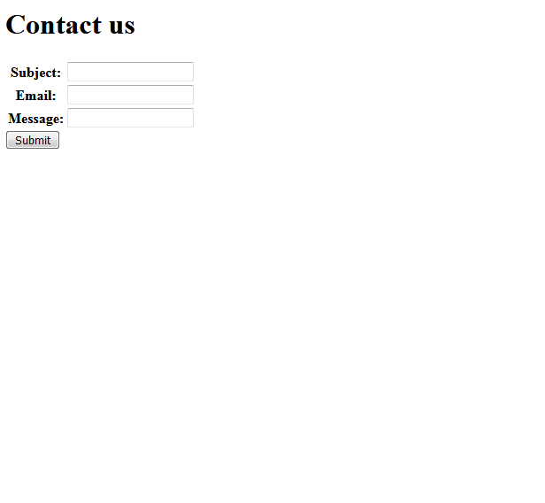
Running The App
Now start the server and open the page http://localhost:8000/contact and
this will load the page contact_form.html with the following output:

Slide 27
Different Form Rendering Options
Django provides us several ways to render the form object in the browser via template.
These are:
{{ form }} will render them all
{{ form.as_table }} will render them as table cells wrapped in <tr>
{{ form.as_p }} will render them wrapped in <p> tag
{{ form.as_ul }} will render them wrapped in <li> tag
{{ form.name_of_field }} will render the field manually

